Slide 1

Rosemount 2410 Tank hub

Slide 2
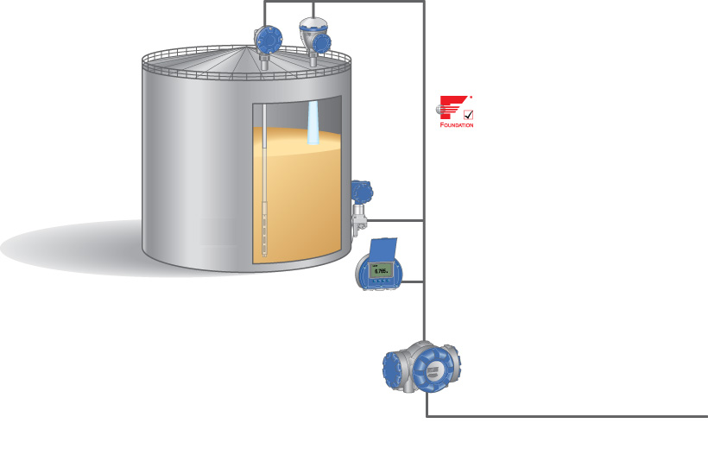
Rosemount 2410
2240S Multi-Input Temperature Transmitter
5900S Radar Level Gauge
Tankbus: FOUNDATIONTM fieldbus
3051S Pressure Transmitter
2230 Graphical Field Display
2410 Tank Hub
TRL2 Modbus / Enraf bus etc.

Slide 3
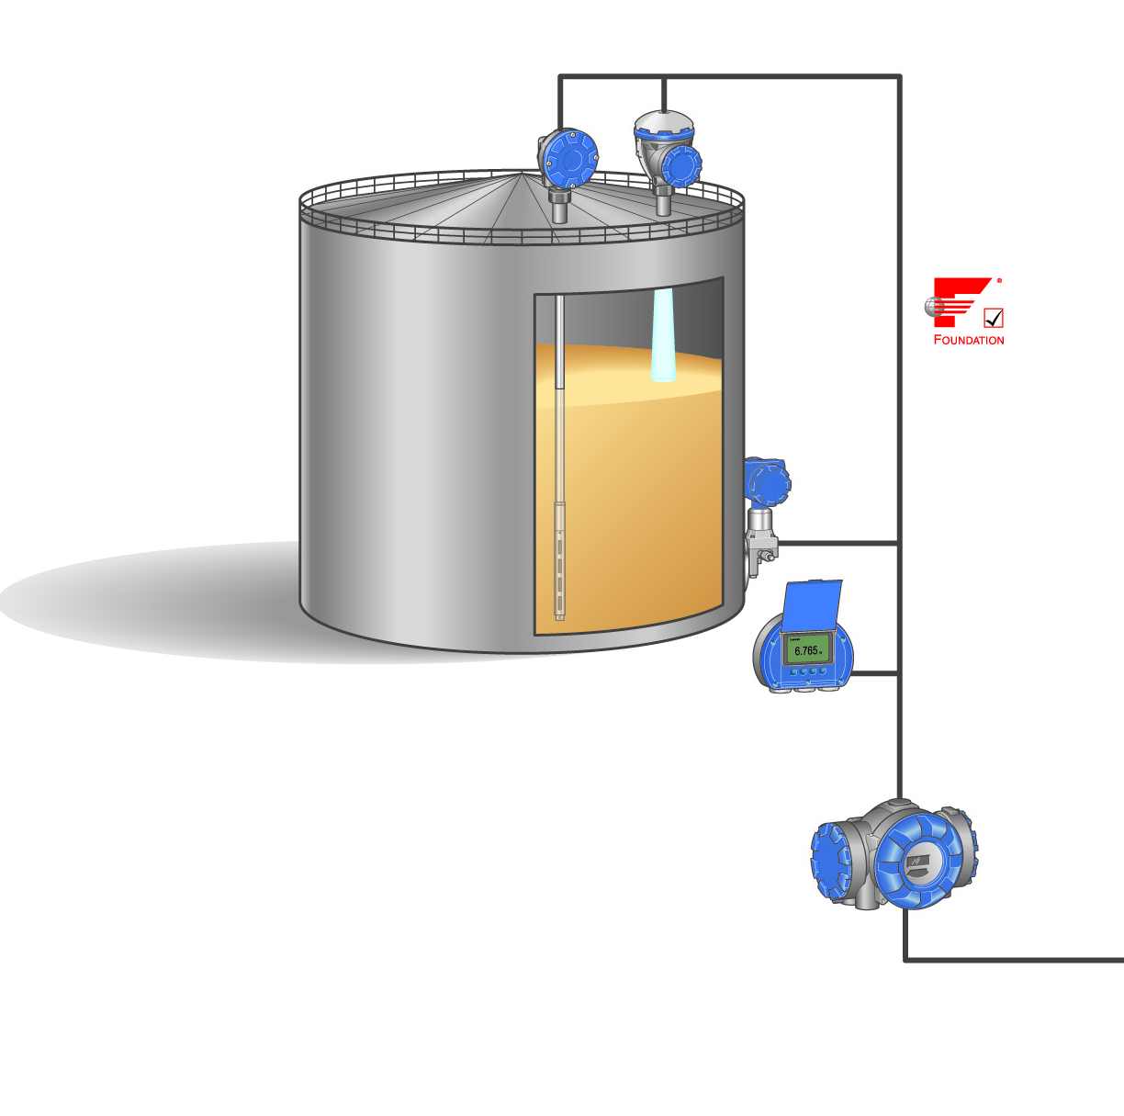
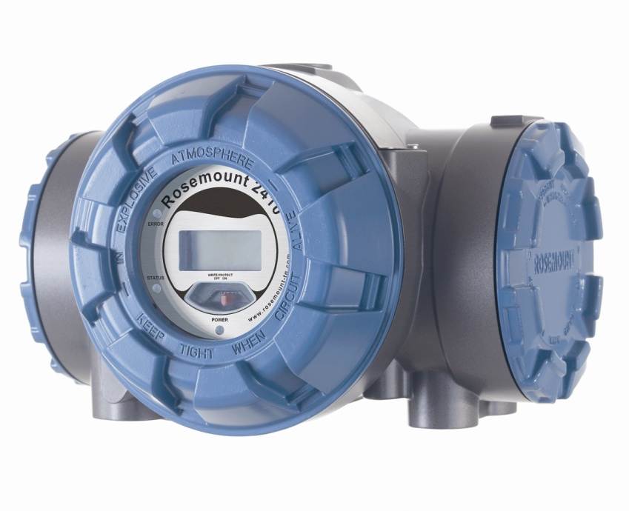
2410 Tank Hub
The 2410 Tank Hub works as the “brain” in the field side of the tank gauging system
It provides power and communicates with all field devices
Handles communication between devices on the tank and the control room

Slide 4
2410 Tank Hub
Foundation™ Fieldbus master on the Tankbus
Identifies and auto-addresses the different field devices connected to the Tankbus
Manages communication
Sets up all FF link/time frame schedule for connected units
Supervises the status of connected equipment

Slide 5
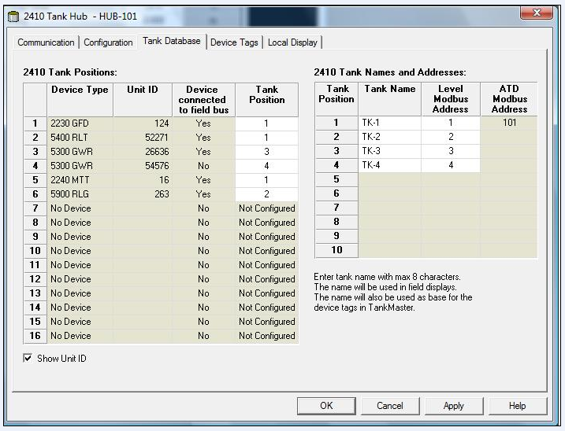
2410 Tank Hub
The 2410 Foundation™ Fieldbus host functions
Keeps Tank Bus “live list” updated
Collect Measurement Values and Status from connected devices
Returns tank data to host at assigned Modbus address

Slide 6
2410 Tank Hub
Calculates
Average temperature
Observed Density (up to 3 tanks)
Volume (TOV)
TOV calculation with predefined tank shapes and 100-point strapping table
Provides measurement values and calculated data to the 2230 display
Supports auto-mapping of data from the field devices for the most common configuration (i.e. one tank with one 5900S and one 2240S)

Slide 7

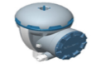
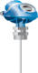
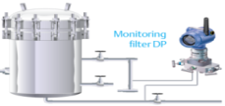
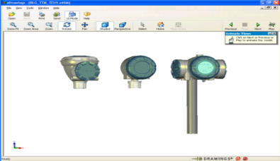
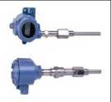
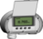

2410 Tank Hub
Supported units at product launch are:
Rosemount Radar Level Gauges: 5900S, 5400 and 5300
Rosemount 2240S Multi-Input Temperature Transmitter
Rosemount 644 Temperature Transmitter.
Single or Multi-spot Temperature Sensors
Rosemount 765 Water Level Sensor
Rosemount 3051 Pressure Transmitters
Rosemount 2230 Graphical Field Display
5300 Radar Level
Transmitter
5900S Radar Level Gauge
3051S Pressure Transmitter
5400 Radar Level
Transmitter
644 Temperature Transmitter with single point sensor
2240S Temp Transmitter
2230 Graphical Field Display
Rosemount TankMaster

Slide 8
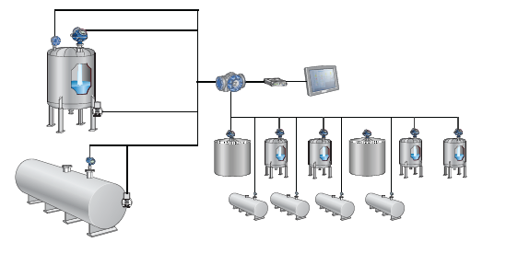
Single and Multiple Tank
2410 available in two versions:
Single tank
Supports one tank in a 5900S system configuration (2-in-1)
TOV calculation with 100-point strapping table
Multiple tank
Model code option
Supports a 5300/5400 system configuration
TOV calculation with 100-point strapping table for one tank
Up to 16 field devices or 10 tanks per tank hub
Hybrid calculations for up to three tanks

Slide 9
2410 Installation Considerations
2-wire intrinsically safe Tankbus (complies with FISCO FF standard)
Power supply for 2410 Tank Hub:
48-240 VAC at 50/60 Hz
24-48 VDC
Power consumption:
Less than 20 W during normal operation
Housing should be grounded according to national and local electrical regulations
Tankbus cabling, screen grounded in tank hub
Built-in termination jumper – normally connected

Slide 10
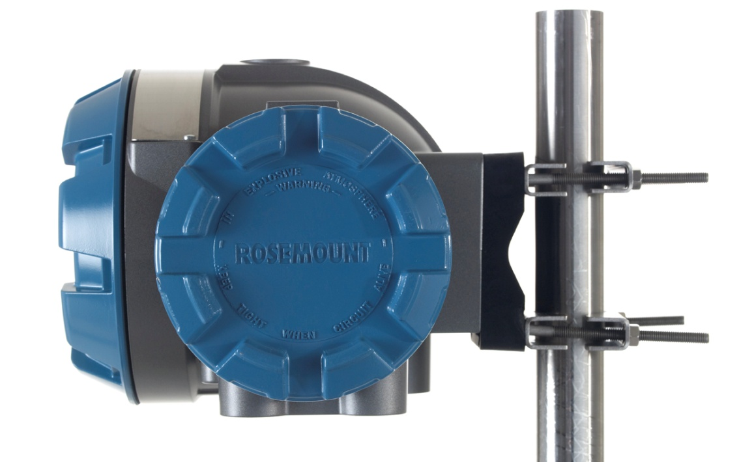
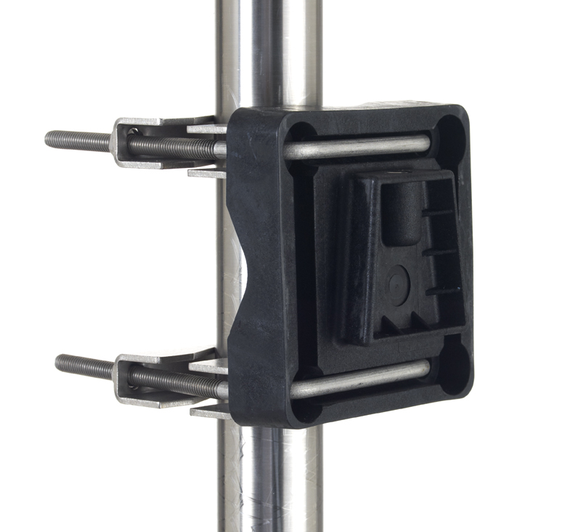
2410 Installation Considerations
Can be wall- or pipe mounted

Slide 11
Power Budget
Rosemount 2410 supplies power to all devices on the Tankbus:
Delivers 250 mA to the Tankbus
The maximum number of devices for one Tankbus depends on:
Tank hub version, single or multi
Number of field devices and their power consumption
Used cabling
All field devices need at least 9V input
Power budget calculator
Field Device | Power Consumption
5900S Radar Level Gauge | 50 mA
5900S Radar Level Gauge, 2-in-1 solution | 100 mA
5300 or 5400 Series Radar Level Gauge | 21 mA
Rosemount 2230 Graphical Field Display | 30 mA
Rosemount 2240S Multi-input Temperature Transmitter | 30 mA incl. sensors
Rosemount 644 Temperature Transmitter | 11 mA
Rosemount 3051S Pressure Transmiter | 18 mA

Slide 12
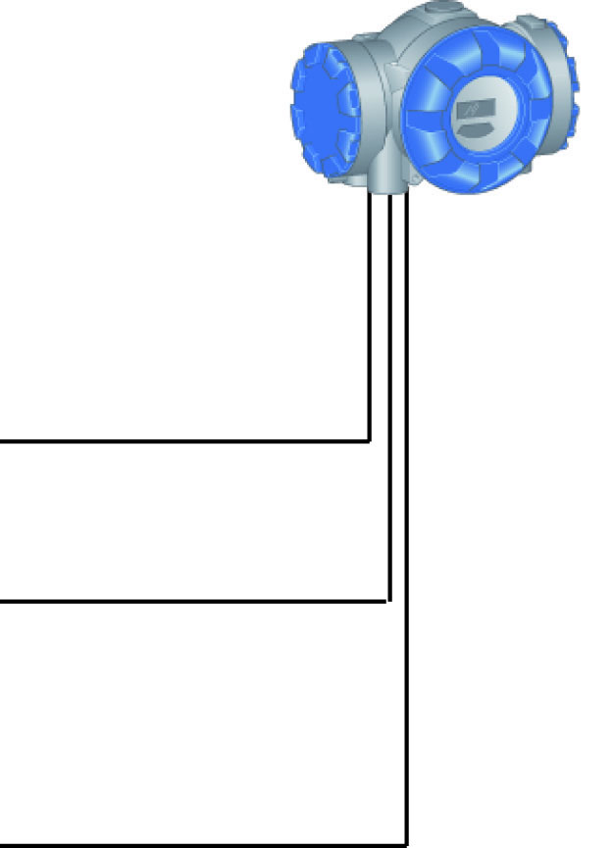
Inputs and Outputs
Two external buses for communication with host systems
Primary bus
Typically used for TRL2 Modbus or RS485
Communicates with 2160 or TankMaster
Secondary bus
Supports various protocols (TRL2 Modbus, Enraf etc)
Allows you to connect to other host systems
Allocated to SIL relay if included
Output relays
Non-intrinsically safe solid state relays
Supports one internal LCD
Used to display data
LCD
Primary Bus
Secondary Bus
Relay Outputs

Slide 13
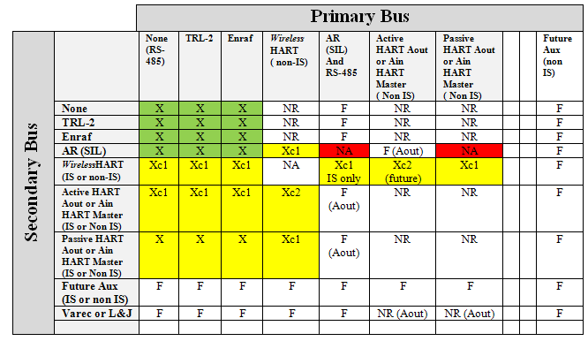
Primary / secondary bus combination matrix
NA = Not Available (it is not possible for some reason).
NR = Not Recommended (possible but not recommended since it will make configuration complicated).
X = Available now, in the near future.
F = Future.
Xc1 = Available but with 50 mA less power available on the Tankbus if Active Analog. Short circuit on Tankbus will reset the 2410.
Xc2 = Available but with 100 mA less power available on the Tankbus if Active Analog. Short circuit on Tankbus will reset the 2410.

Slide 14
Solid State Relays
2 relays (K1+K2) configurable to supervise level, temperature, any TV or status etc
Normally open/closed
Max: 350 VAC/VDC, 80 mA
Output to horns, signal lamps etc
Test feature, manual control of relay function
1 relay dedicated for SIL 2/SIL 3 overfill functionality
Comes with SIL option, separate board
Always in normally closed (energized) operation
Max 260 VAC/VDC, 100 mA
Typical, output connected to ESD (emergency shut down) system

Slide 15
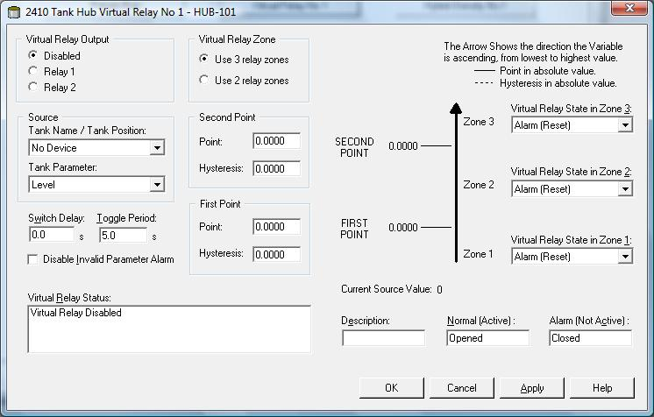
Virtual Relays
Several virtual relays can trigger the same physical relay
Up to 10 virtually relays
The two Non-SIL relays (K1 + K2) are controlled by virtual relays
Example: High alarms from any connected tank can activate one relay

Slide 16
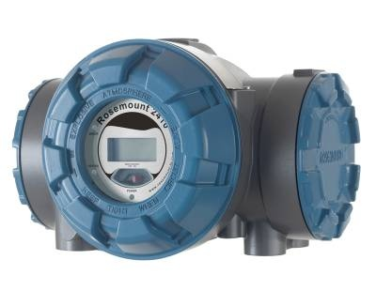
Components
Display
Non- Intrinsically Safe Terminal Compartment
Intrinsically Safe Terminal Compartment
Cable entries for non-IS connection
Cable entries for IS connection
Write Protection Switch
Grounding terminal

Slide 17
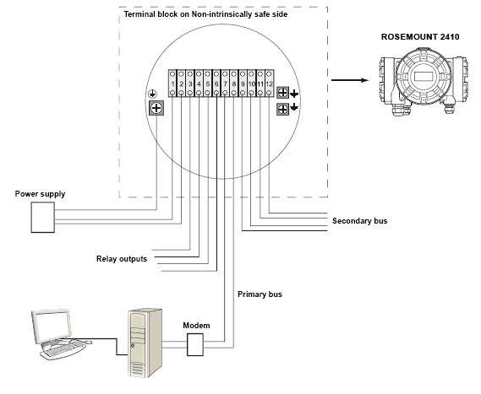
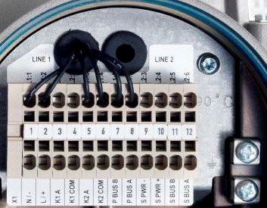
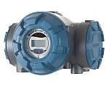
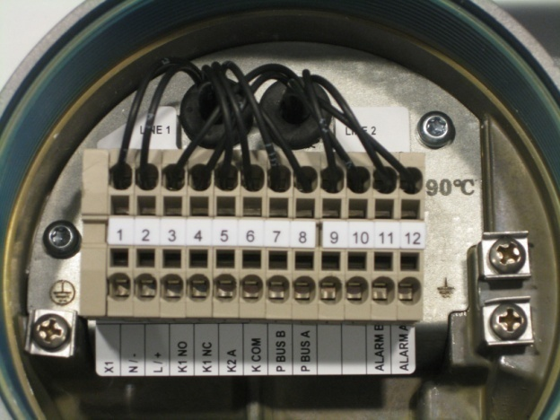
Wiring Diagram Non-IS side
2410 Standard Non-IS Safe side
2410 SIL Non-IS Safe side

Slide 18
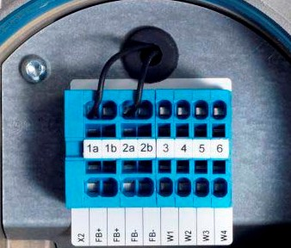
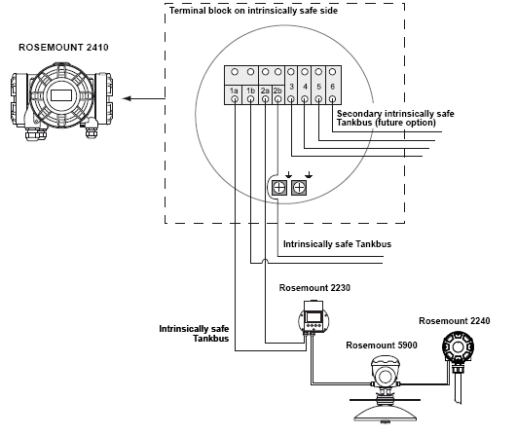
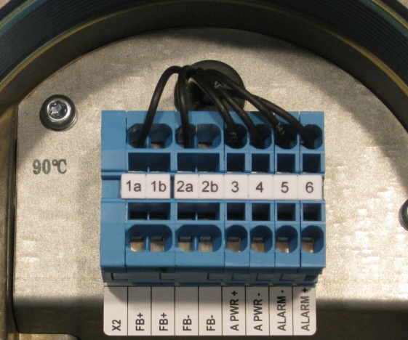
Wiring diagram IS side
2410 Standard IS safe side
2410 SIL IS Safe side

Slide 19
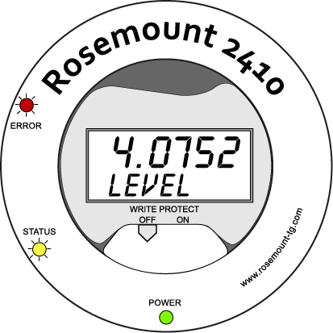
Front Panel with Integrated Display
Display for presentation of mesaured data
Specified in TankMaster WinSetup
Two rows showing
Measured values
Variable type & unit
Toggles between values at a configured rate
Measurement value
Toggling between measurement parameter and measured unit
Write protection switch

Slide 20
Variables on Display
Variable | Presentation on display | Description
Level | LEVEL | Product Level
Ullage | ULLAGE | Distance from upper ref.point to product surface
Level Rate | LRATE | The speed of level movement up or down
Signal Strength | SING S | Signal amplitude of the surface echo
Free Water Level | FWL | Free water level at the bottom of the tank
Vapor Pressure | VAP P | Automatic or manual Vapor Pressure value
Liquid Pressure | LIQ P | Automatic or manual Liquid Pressure value
Air Pressure | AIR P | Automatic or manual Air Pressure value
Ambient Temperature | AMB T | Automatic or manual Ambient Temperature value
Vapor Average Temp | AVP T | Average temperature of vapor above the product surface
Liquid Average Temp | LIQ T | Average temperature for all spot sensors submersed in liquid
Tank Average Temp | TANK T | Average value of all temperature sensors in the tank
Spot 1 Temperature | TEMP 1 | Temperature value for spot sensor 1
Observed Density | OBS D | Automatic or manual Observed Density
Volume | TOV | Total observed volume
Flow Rate | F RATE | Flow rate
User Defined n | UDEF n | Up to 5 user defined variables

Slide 21
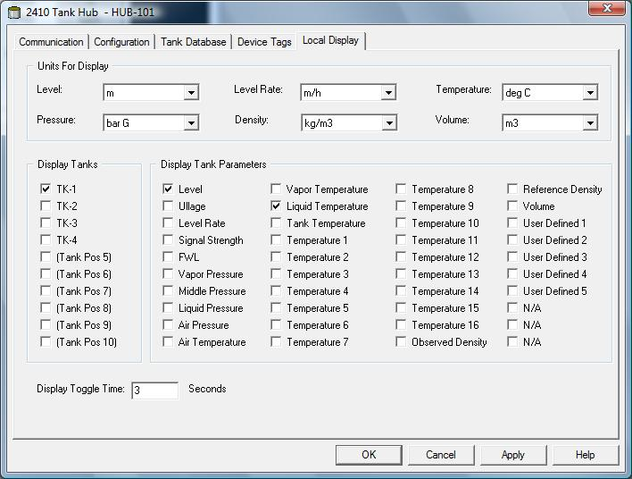
Variables on Display
Displays tank parameters, configurable via WinSetup

Slide 22
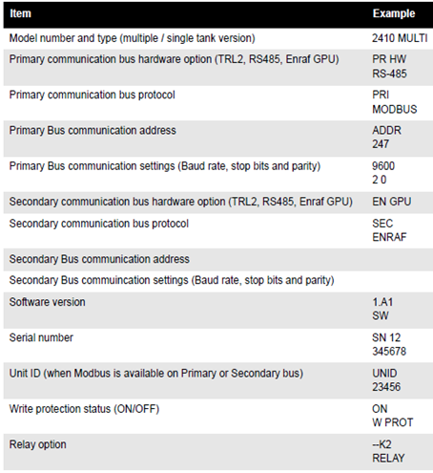
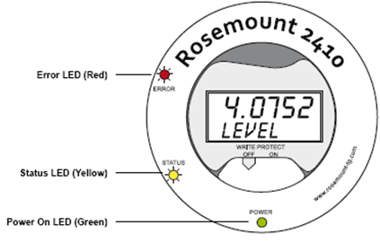
Display During Start-up

Slide 23
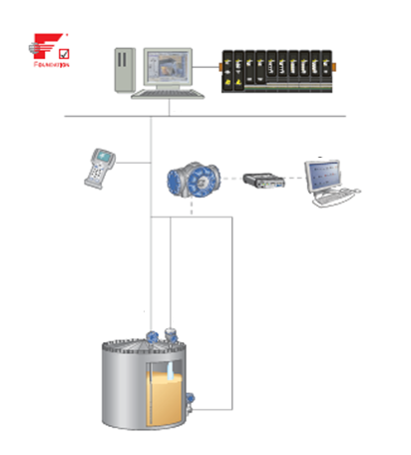
Configuration
Configuration tools
TankMaster WinSetup connected via:
RS485 Modbus
TRL2 Modbus
Enraf (EBM)
AMS, in wireless systems

Slide 24
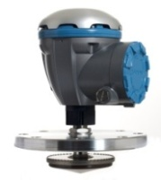
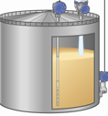
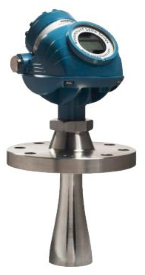
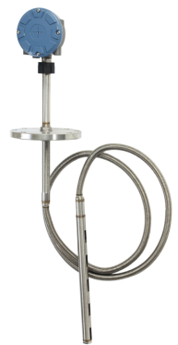
2410 Tank Hub, simplified Data Block Diagram How to get measurement data from devices into the Host
Tank Measurement Variables (TMV)
Transmitter variables
Level
Ullage
LevelRate
Temp 1-16
FWL
Pressure
Etc....
Manual values
Unit Conversion and Scaling
Primary bus
Secondary bus

Slide 25
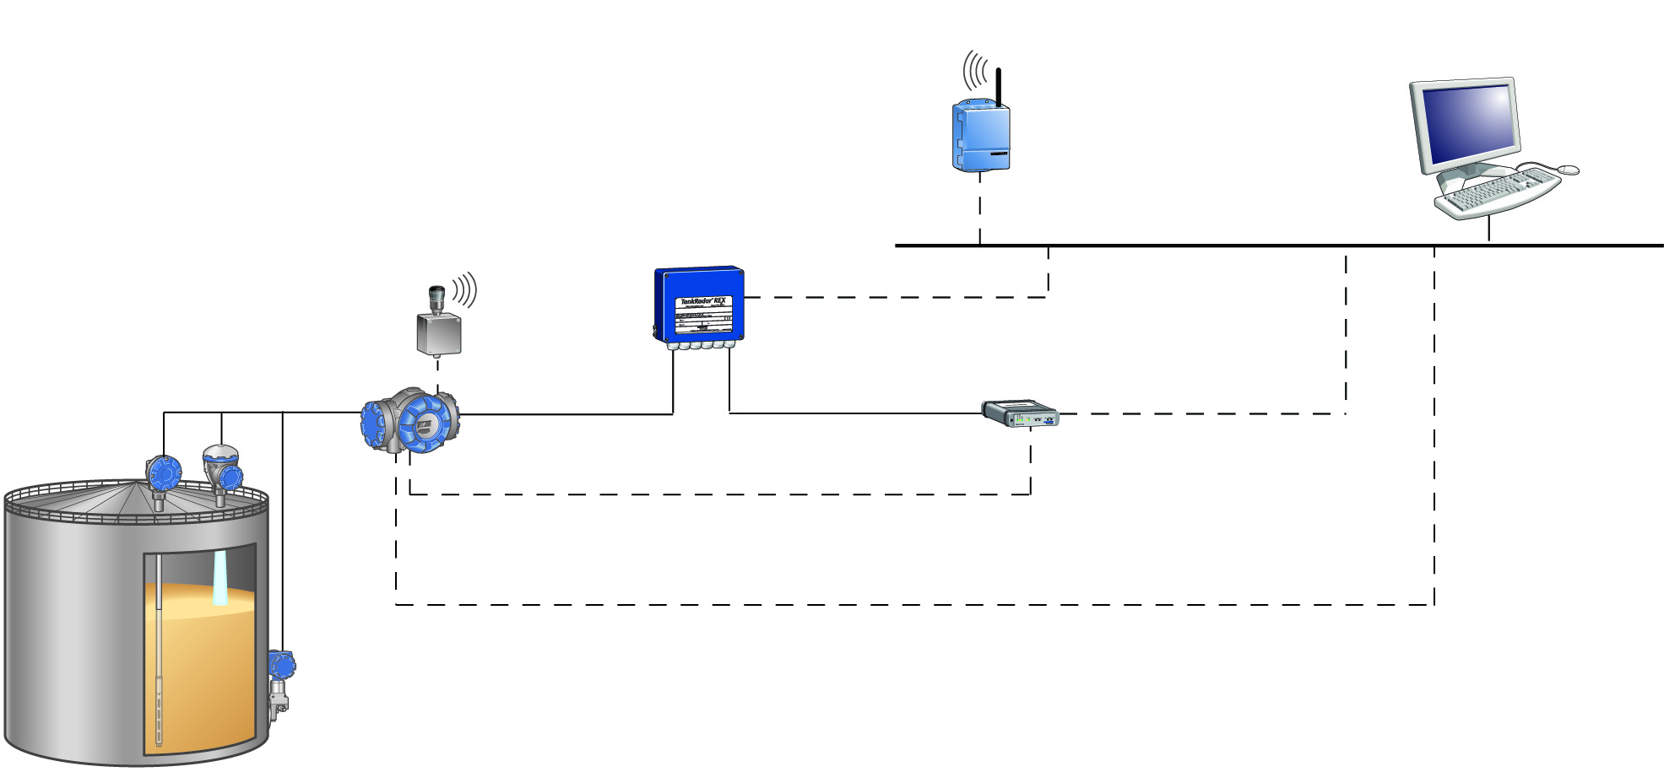
Connection to TankMaster
TankMaster PC
WirelessHART
Wireless Gateway
2160/65/75 Field Communication Unit
Wireless THUM™ Adapter
RS485 or RS232
Tankbus
2410 Tank Hub
Modbus
USB or RS232
TRL2
Modbus
RS485
Modbus

Slide 26
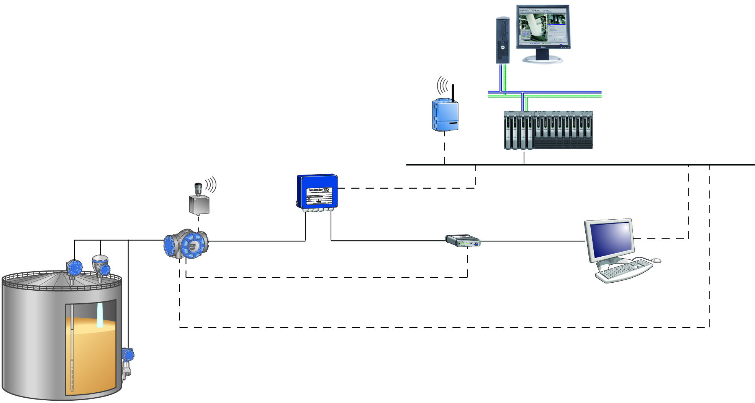
HOST Communication
2410 communicates with the host
Directly
Via Field Communication Unit Rosemount 2160/2165/75
Via TankMaster PC
WirelessHART

Slide 27
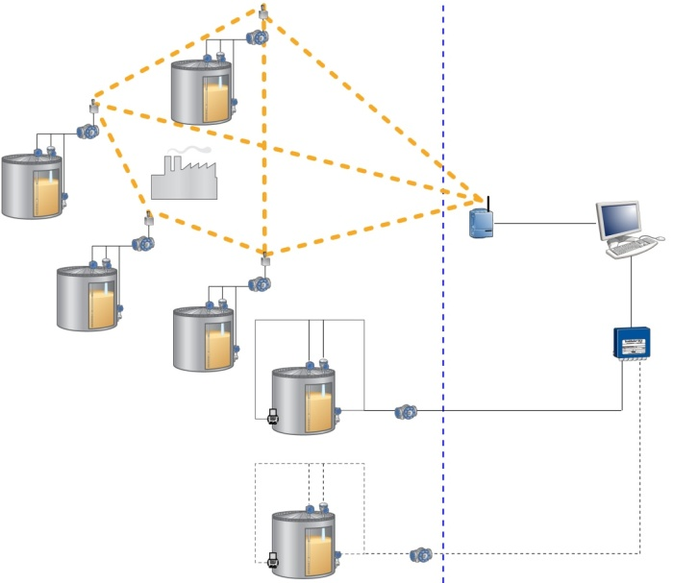
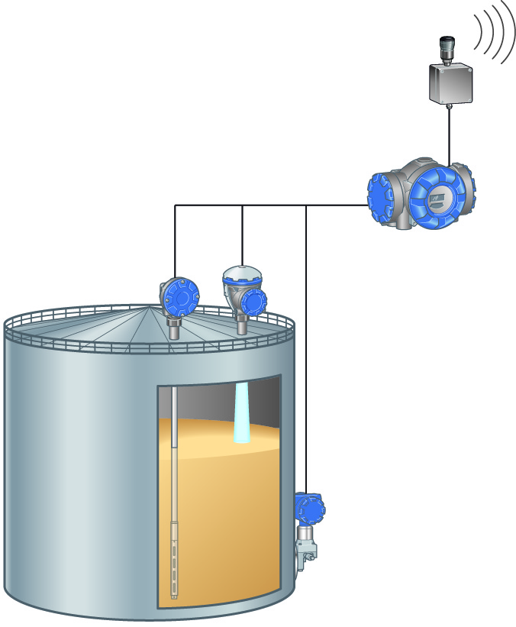
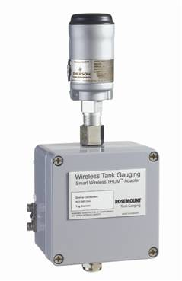
Raptor Wireless
Smart Wireless THUM Adapter
Wireless data link between different tank hubs and a Wireless Gateway
The THUM adapter is connected to the IS side of the 2410 Tank Hub
Requires the Wireless HART connectivity option in tank hub.

Slide 28
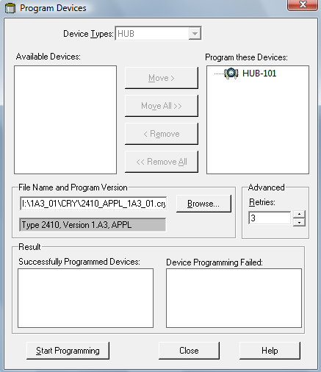
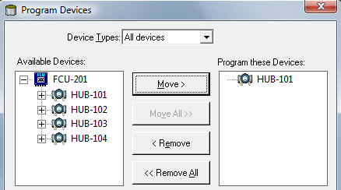
Software Upgrade
Possible to upgrade the 2410 software
Done in TankMaster WinSetup
Possible to upgrade several 2410 at the same time

Slide 29
Simulation mode
Verify communication between 2410 and HOST system without connecting field devices
Choose parameters to be calculated based on simulated tank data input
Level, avg temp, liq pressure tec
Simulation HREGS
Starting with 3800
Simulation Parameter | Simulation Holding Register
Product Temperature | HR3868
Volume | HR3994
Observed Density | HR3976

Slide 30
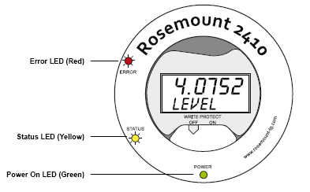
Device Status in Display
LED Type | Color | Description
Error | Red | Turned off in normal operation. If an error occurs, the Error LED flashes a sequence corresponding to a certain error code
Status | Yellow | Blinks at a constant rate of one flash every other second in normal operation to indicate the 2410 software is running
Power On | Green | 2410 is powered on

Slide 31
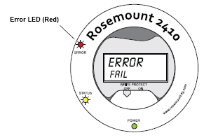
Type of Error
The error led will flash in a sequence that corresponds to the error code
Code | Error
1 | FPROM
2 | HREG
3 | Software
4 | Other memory error
5 | System
6 | Display
7 | AUX
8 | FF Stack
9 | Tankbus
10 | Host Communication
11 | Data Manager
12 | Configuration

Slide 32
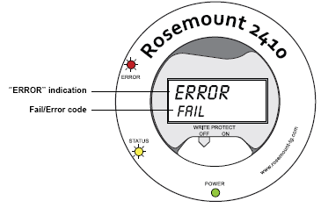
Error Messages
Display shows software and hardware error codes
Upper row: Error
Lower row: FAIL/Error Code
Code | Error
RAM | RAM Failure
FPROM | FPROM
HREG | Holding register error
OMEM | Other memory error
SYS | System error
DPLY | Display Error
AUX | AUX
FF ST | FF Stack
TBUS | Tankbus
HOST C | Host
D MNGR | Data Manager
CFG | Invalid Configuration
SW | Software

